Slide 1


CPCESU Project
Management System
UGRADS Presentation
+
Joseph Remy [Team Lead], Colton Nunley, Jasque Saydyk
Faculty Mentor: Ana Paula Chaves Steinmacher
Notes:
[Colton]
15 seconds
Questions for presentation:
Gantt chart, show to end of project or is current fine? Or have another with a much bigger view of project with just milestones, then

Slide 2
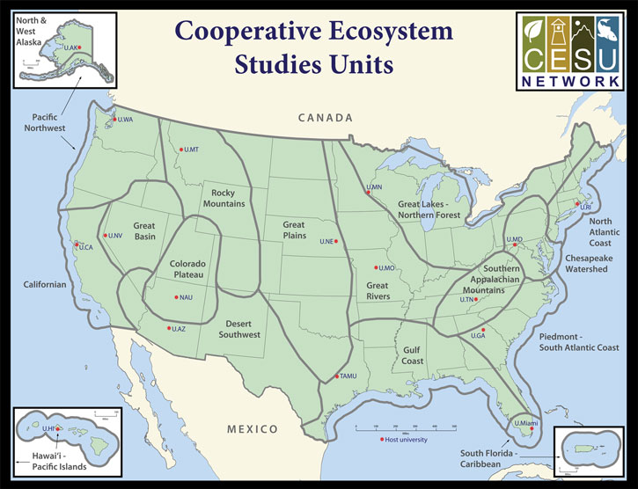
Colorado Plateau Cooperative Ecosystem Studies Unit
CPCESU is a part of a national consortium for resource stewardship
  Dozens of projects
    Species studies
    Building trails
  Hundreds of modifications
  Millions of dollars
Notes:
[Colton]
30 seconds
Hook/Big picture
Nature is very important part of who we are as humans. It is our foundational responsibility to be stewards of mother nature. This planet is our home...
CPCESU
The Colorado plateau fosters this love and stewardship by supporting and maintaining ecological projects across the SW. They act as an intermediary between various Federal and non federal agencies to provide project projection and statistics as well as maintain current projects with what they refer to as ‘modifications’.
Specifics
To do this, the Colorado Plateau gets dozens of project proposals, hundreds of modifications, and millions of dollars each year to setup, organize, fund, track, and archive these projects. They accomplish this by utilizing data from past projects. Their current project management system is hindering their ability to work effectively.
The CPCESU is a government agency which organizes federal agencies and Native, state, and local governments with non-governmental organizations and universities to complete a variety of conservation projects from investigating archeology sites to conducting zoological surveys.
All of this helps preserve the nature and history of the Amercian Southwest, allowing us to learn more about the impacts we have our fragile ecosystem<move up wide to specfic>
To do this, the CPCESU gets dozens of project proposals, hundreds of modifications, and millions of dollars each year to setup, organize, fund, track, and archive these projects.
Which is common thing for organizations to do, and each organization is going to have their own system to manage their projects, whether it’s formalized or not
The CPCESU is a part of a national consortium that is focused on assisting organizations, like the National Park Service and the Bureau of Land Management, draft projects to be done by university professors and students, connecting these organizations with subject matter experts if need be, and providing a legal contract stating how these projects are to be completed, tracking these projects until they are completed, and transferring the funding for these projects over from the organization to the budget for the project.
This is something that a bunch of organizations do, make take projects, assign them, and track them throughout their lifetime, given them a budget to work with, and each of their management schemes cater their particular needs and niches. Even we in software dev use other tools to help us track the projects we are working on
Old Rough Slide content:
Colorado Platue Coorperative Ecosystem Studies UnitIn they help connect federal agencies and organizations that want to have a project that does a ecological studies etc, with experts for various projects and connect them, establishes a contract between the two, distributes funds accordingly, and tracks the project throughout it’s life
CPCESU:
The CPCESU is a derivative of the CESU which a national organization which is spread among many different biogeographical areas of the US. The CPCESU is hosted by NAU with Dr. Todd Chaudhry as the Research Coordinator and Laurie Thom as the Program Coordinator. They are going to be the main users for our end product. Both of them help many different federal agencies come up with a viable ecological project plans based on past project experience and statistics. The Colorado Plateau helps other federal agencies work on ecological projects. Whether that's studies, help building and maintaining a trail, or ecological investigations.

Slide 3






Project Workflow
Proposal
U.S. Forest Service starts inquiry for a plant species study
Acceptance
Both parties sign and the study begins
Termination
NAU completes study. Final report is created
Drafting
NAU assigned as non-government contractor, project agreement created
Tracking
CPCESU tracks project including modifications
Reporting
Project archived and used for statistics and reporting
Notes:
[Remy]
= Before diving into the problems and solutions, this is their current project workflow at a glance<pause>
= First fed agency proposes a new project and a non-federal organization is found
= The contract is drafted and passed back and forth between fed, non-fed, and CPCESU till it is final
= Once the contract is signed by both fed and non-gov parties, work starts
= Our client tracks the project including any modifications
= Once a project is terminated, a final report is created by non-fed org and shared with fed agency and Colorado Plateau
= Lastly, the project is archived and used for reporting <end>

Slide 4
Problems
Proposal
Allow organizations to Submit proposals
Acceptance
Notify work has started
Termination
Archive projects
Drafting
Validate information on the contract
Tracking
Track and
Modify projects
Reporting
Distribute information to management and public
Notes:
[Remy]
= From the current project management workflow, we have summarized the problems at each step into one or two words each<pause>
= Tracking the projects, especially modifications, → crux of our client’s problems (shown in yellow)
= Modifications - adding or removing time, money, and/or personnel
= The biggest problem = tens of millions of dollars unreported → bad tracking and reporting
= Goal = Report to NAU, their host organization, 50% overhead, only a 17.5% indirect rate
= This can impact whether or not NAU wants to host the organization in the future

Slide 5

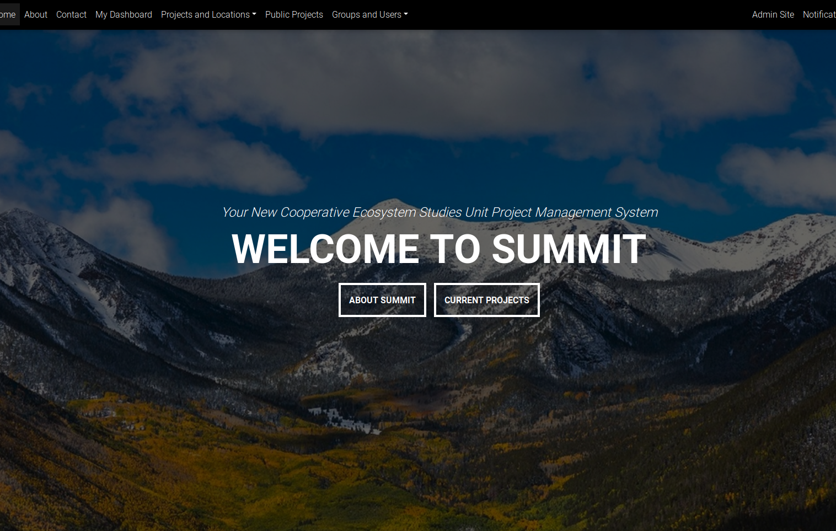

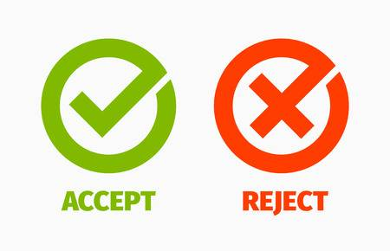

Business Goals
All in One
Faster Entry
Speed Up Operations
Validate
Notes:
[Colton]
30 seconds
Since their founding, they have used an off-the-cuff approach to project management using
Email to setup and update the projects
Microsoft Excel to track the projects
Microsoft Access database to archive the projects
Shared file system to store the documents of the projects

Slide 6
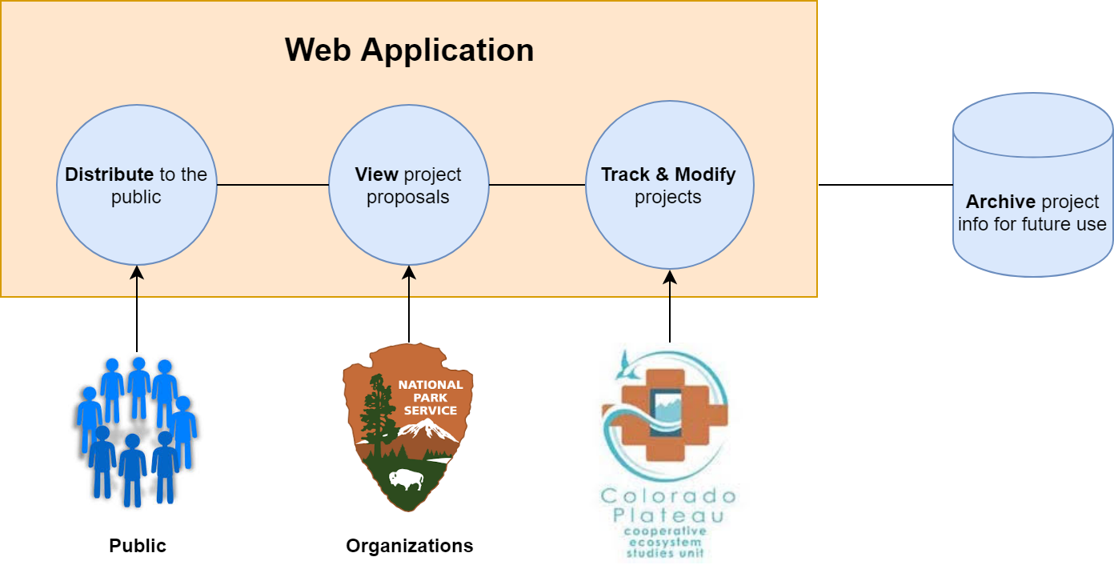
Solution - “Summit”
Notes:
[Colton]
30 seconds - 1 minute
The solution will be a secure web application built with Django with a PostgreSQL database that will track projects throughout their lifetime, archiving them when they are closed and disallowing edits to them
Hosted on its
Note web framework
!!!!!!!!!!!!!!!!!!!!!!!!!!!!!!Number the slides!!!!!!!!!!!!!!!!!!!!!
Key words to solve the various stakeholder problems
Where in solution addressing key works in previous slide
Should be clear in mapping the problem to the solution with keywords

Slide 7
Key Requirements
Track and modify projects
Notified of project deadlines
Ensure correct data
Autofill from a document
Export data from searches
Public searching through projects
Notes:
[Jasque]
As a <user type>, I want <some goal> so that <some reason>
I understand, at a glance, what the project status is
Database stays updated
common errors are not made
I don’t have to type in all of the data
I can inform organizations what they have done and to report to upper management

Slide 8
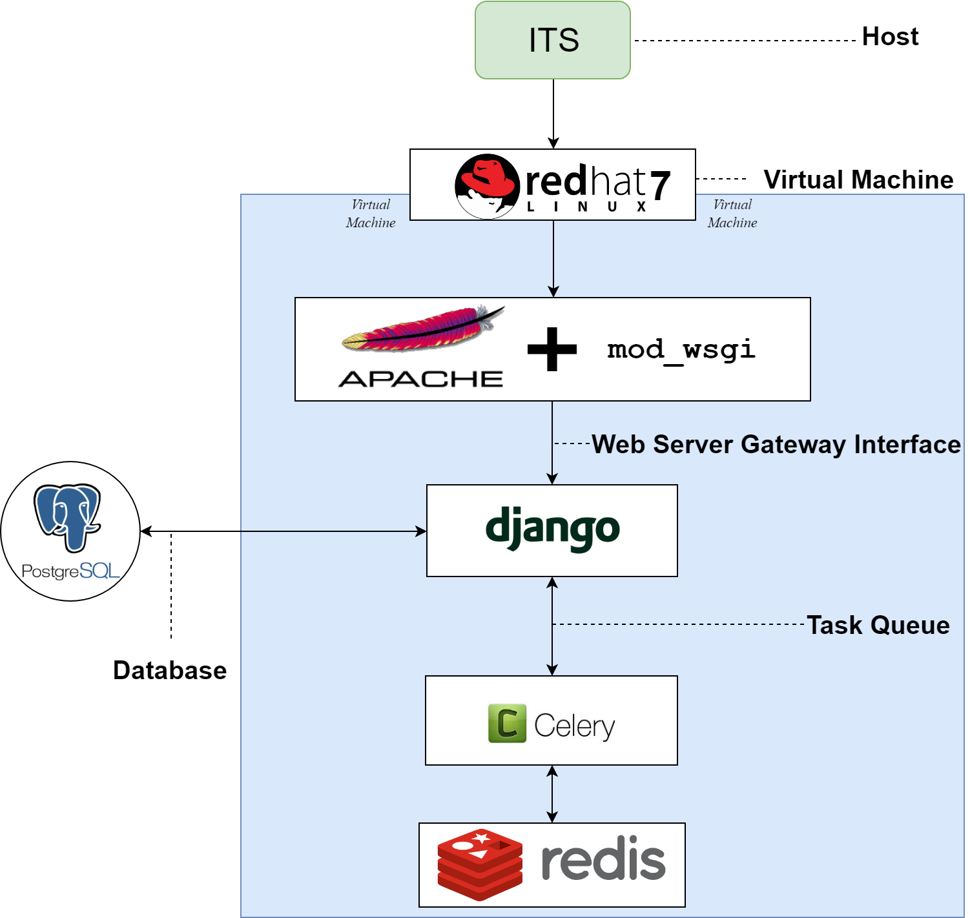
Solution System Diagram
Notes:
[Colton]
30 seconds - 1 minute
Talk more to why we chose the technologies that we did (i.e postgres, apache mod-wsgi, django, redhat7)
Update diagram with new font
-ITS was chosen as the host since the CPCESU is hosted by NAU, therefore there would be constant support for the employees from NAU ITS.

Slide 9
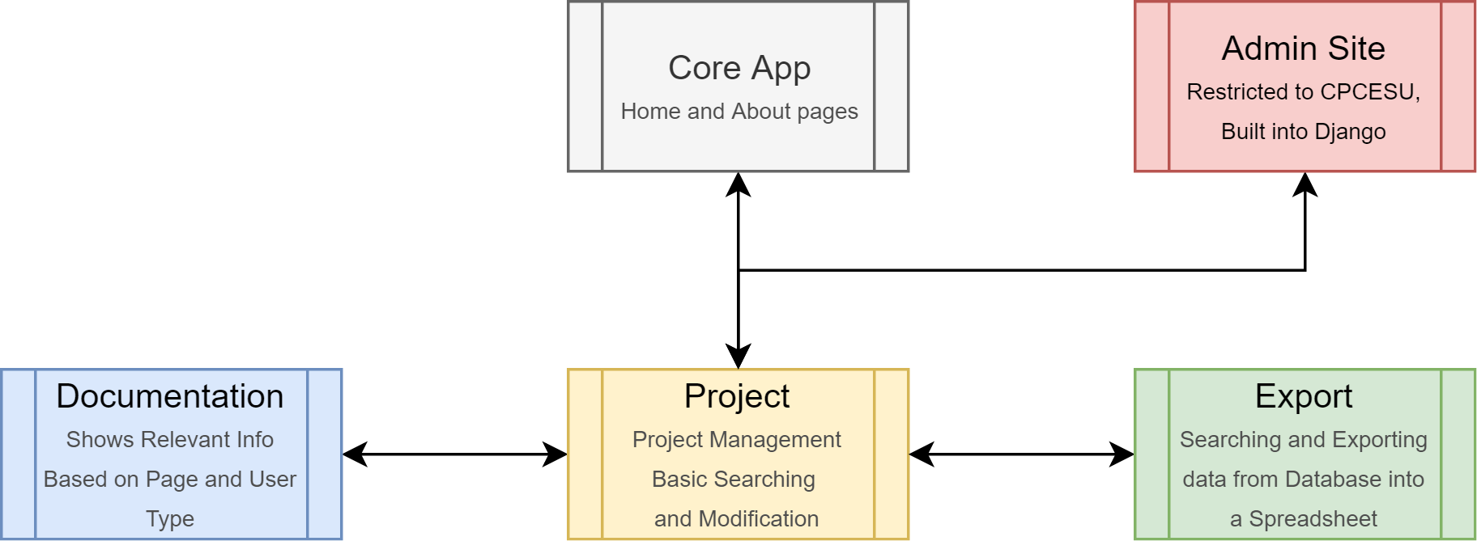
Modular App Design
Each app is connected via Python imports and URL configurations
Notes:
[Colton]
30 seconds - 1 minute
We dont have a flat “one app” for the whole project, we divided into different applications and libraries. And each app will have its own separate MVC that is linked together by urls.py
Work in tandem without having to rely on each other for functionality

Slide 10
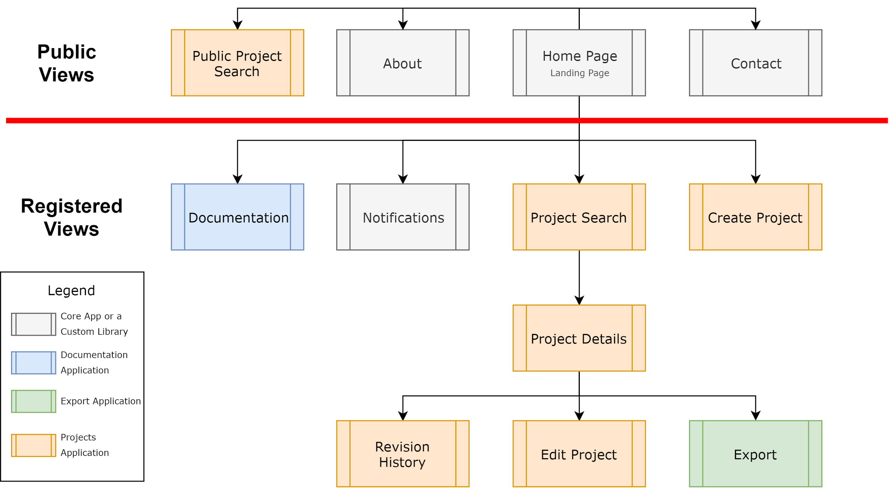
Simplified Sitemap for Authenticated Users
Notes:
[Joseph]
To cater to our different user groups, we have split the site map into two domains:
Top = public
Bottom = registered users
Views from different apps and libs (color coded)
Connections in between are based on user interfaces and URL configs
The four boxes above red → public views
Works for both the anonymous and registered users
General use (home, about) and public project searching and viewing
Below the red line → our client and federal agencies
In blue is the documentation app which has symbolic links to every page you see here that has documentation
Next to that is the notification center, which has automatic reminders for active projects
Lastly, in orange and green, is the project management system, which handles creating, tracking, and modifying projects

Slide 11
Current Status

Slide 12

Centralized functionality and data accessibility by different user groups
Notes:
[Jasque]
This takes us to the homepage of our website, which will centralize the functionality of the various tools the CPCESU previously used to manage projects into one, holistic website/product
as viewed by a public user. We only have access to basic information on the CPCESU and a list of public information regarding the projects they are currently doing.

Slide 13
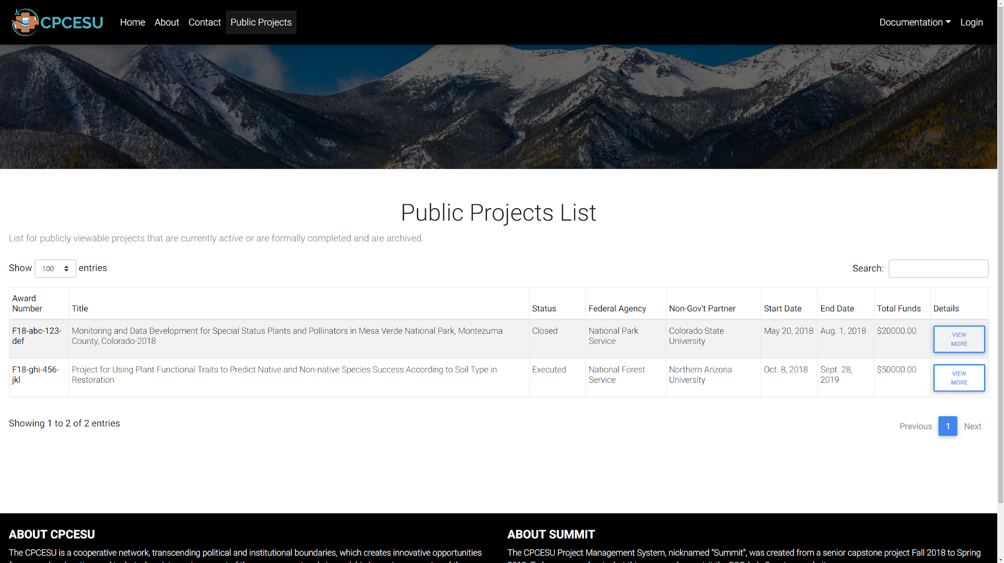
Distributing project information to the public
Notes:
[Jasque]
This takes us to the homepage of our website, which will centralize the functionality of the various tools the CPCESU previously used to manage projects into one, holistic website/product
as viewed by a public user. We only have access to basic information on the CPCESU and a list of public information regarding the projects they are currently doing.

Slide 14
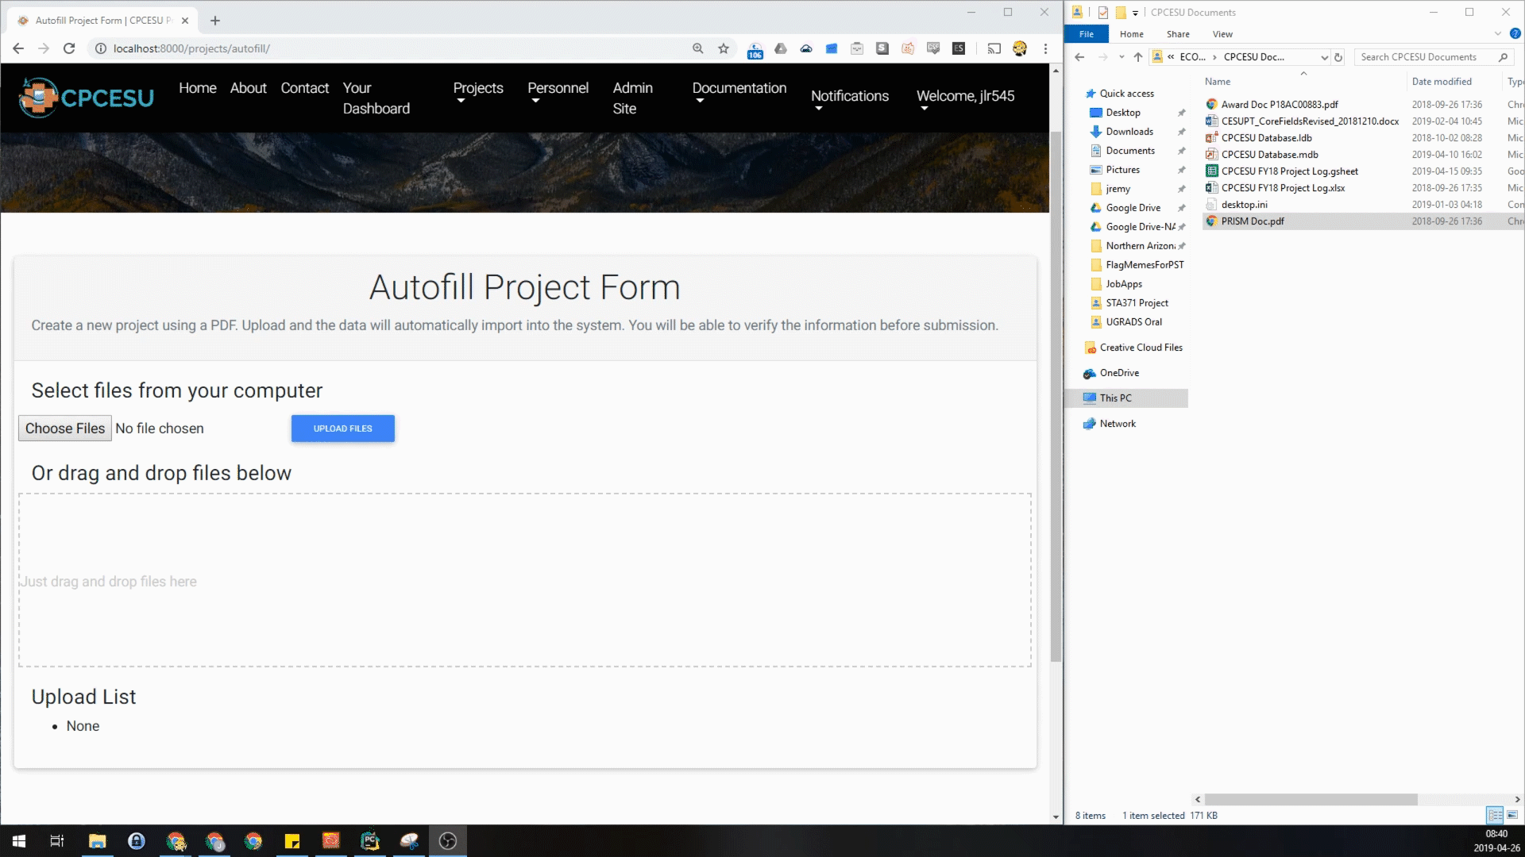
Submitting projects automatically for our client and federal agencies
Notes:
[Jasque]
This takes us to the homepage of our website, which will centralize the functionality of the various tools the CPCESU previously used to manage projects into one, holistic website/product
as viewed by a public user. We only have access to basic information on the CPCESU and a list of public information regarding the projects they are currently doing.

Slide 15
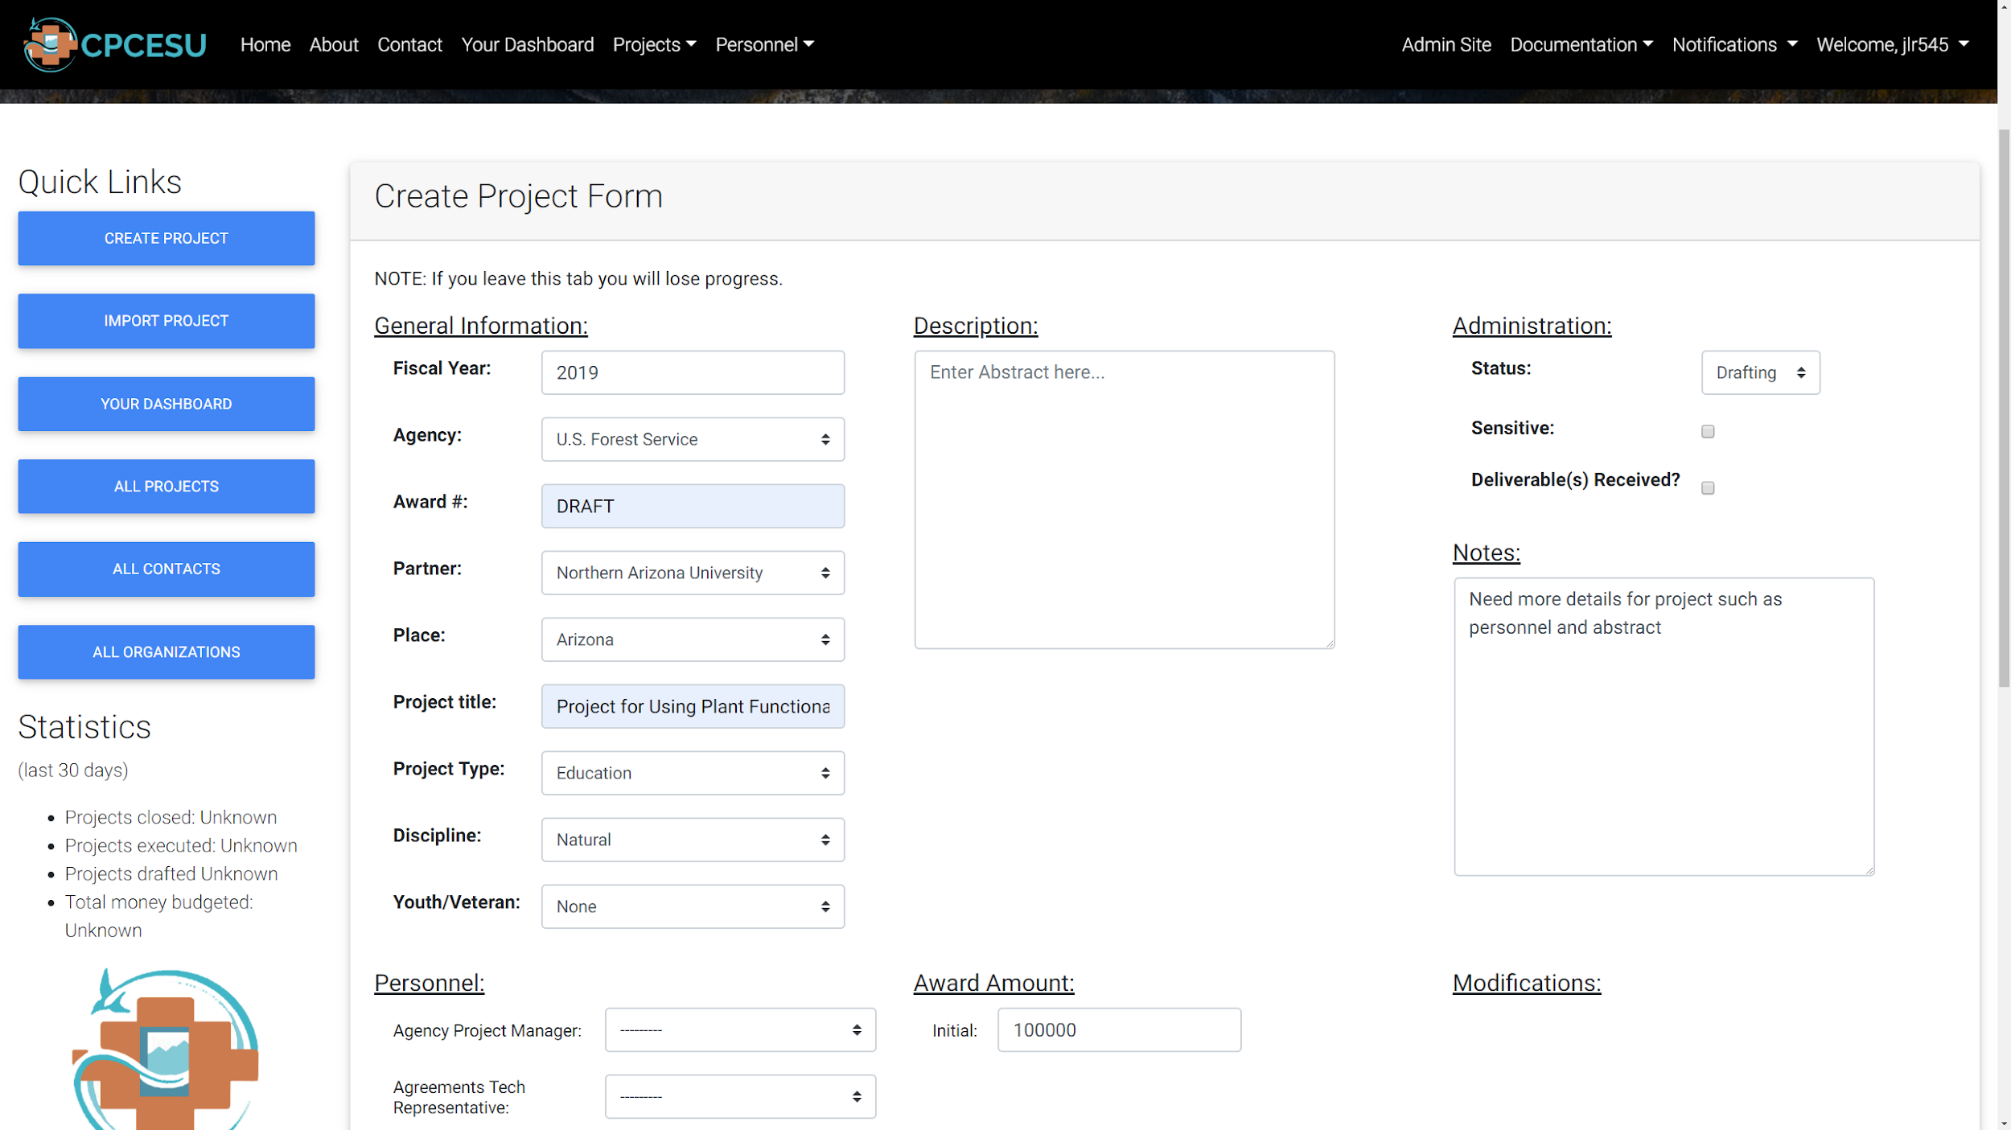
Validating user data to prevent fragmentation and assure data integrity
Notes:
[Jasque]
This takes us to the homepage of our website, which will centralize the functionality of the various tools the CPCESU previously used to manage projects into one, holistic website/product
as viewed by a public user. We only have access to basic information on the CPCESU and a list of public information regarding the projects they are currently doing.

Slide 16
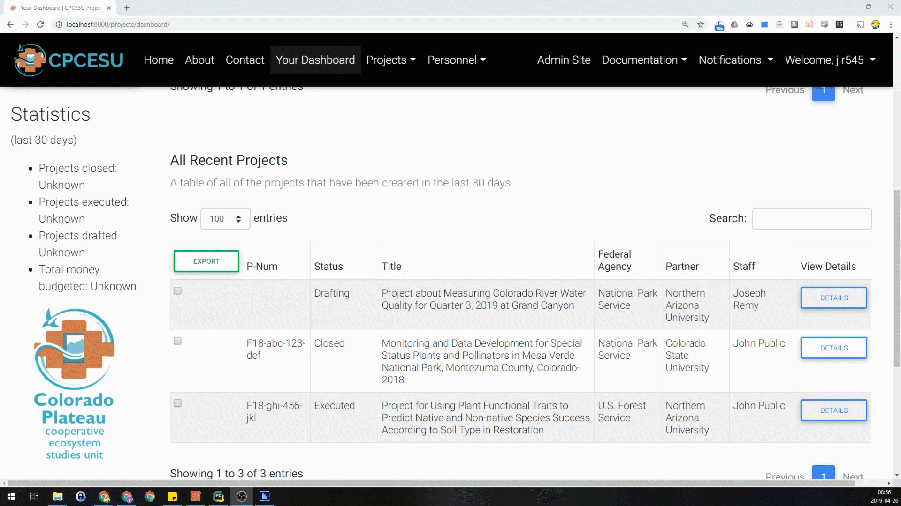
Tracking and searching for projects; Exporting project data
Notes:
[Jasque]
When logged in, all of the functions of the website opens up to us. We are currently looking at the main dashboard of a user allowing them to track and search through projects [descibe what the searching can do]
When we click on edit for any project

Slide 17
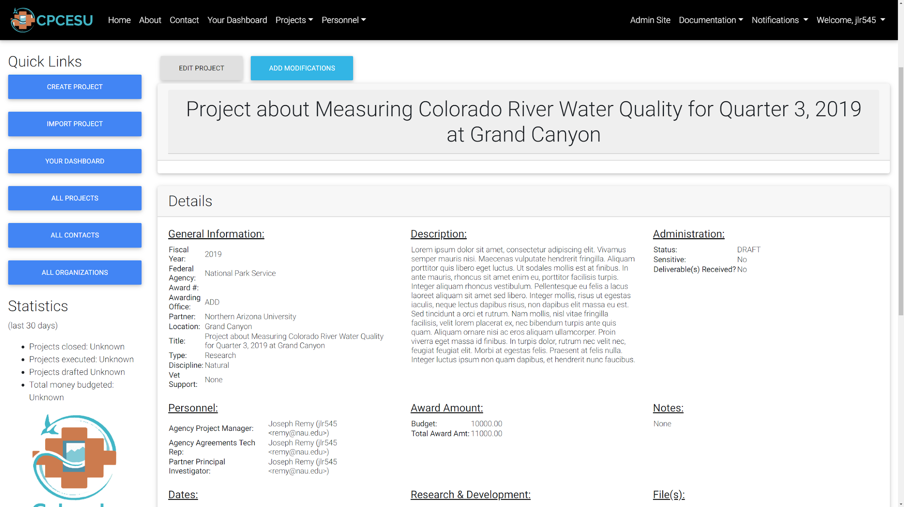
Easier access to project data to decrease overhead and increase efficiency
Notes:
[Jasque]
We get taken into it’s details page, which allows ^
Decreased clicks
This makes it significantly easier to modify a project

Slide 18
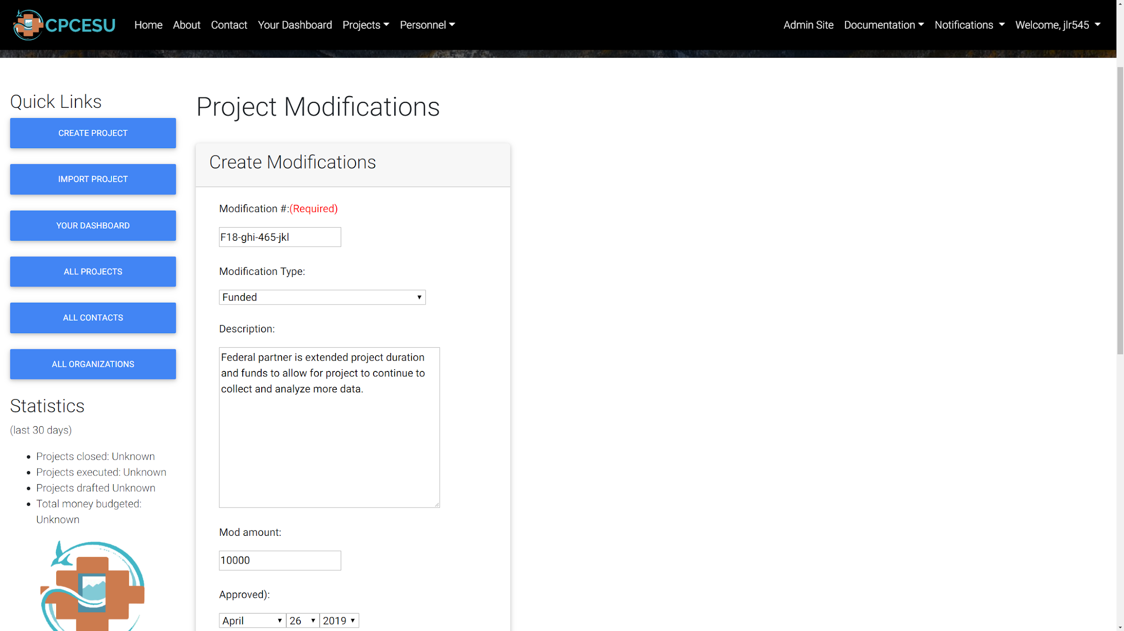
Projects can be modified in real-time using one consolidated application
Notes:
[Jasque]
Since access to the system is consolidated into one application
Which is the primary reason why our client approached us with this project, as they lose millions of dollars each year not being able to easily modify projects with new budgets amounts as conditions change with the project. Whereas previous it took edits looking through and editing files in 4 separate applications, we’ve tied this into one consolidated application that’s only 4 clicks away from editing that data.

Slide 19
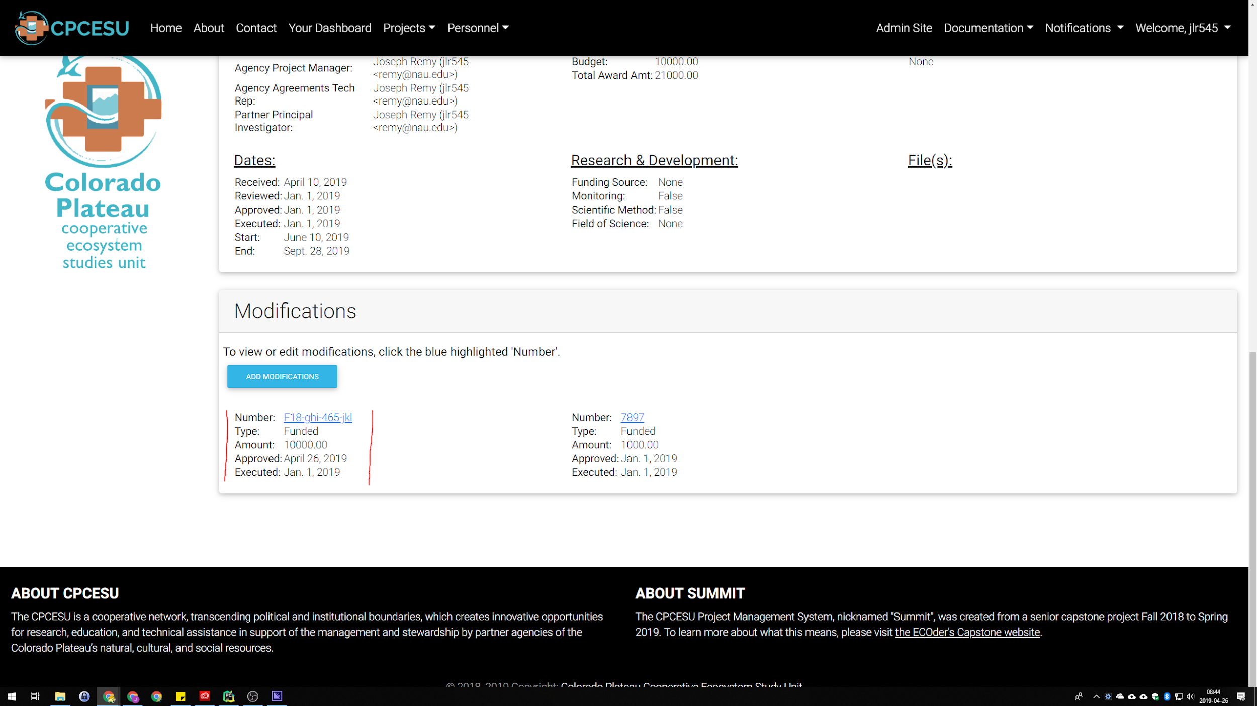
Easier access to project data to decrease overhead and increase efficiency
Notes:
[Jasque]
We get taken into it’s details page, which allows ^
Decreased clicks
This makes it significantly easier to modify a project

Slide 20
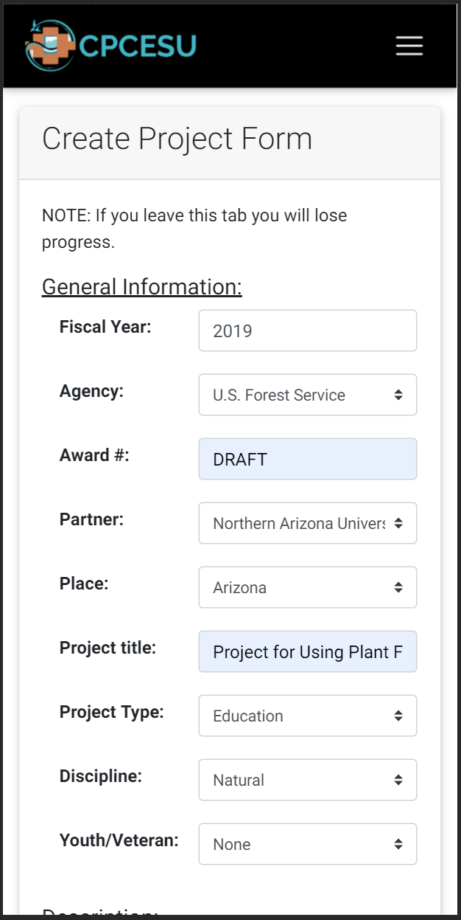
Website is accessible across numerous platforms and browsers.
Desktop
Mobile
Notes:
[Jasque]
Federal computers

Slide 21
Early Risks and Feasibility
Learning curve too high | 25% | High
  Overcome with early prototypes
Unknown or overlooked requirement | 10% | Mid to High
  Procedures to modify the SRS after it is signed
Security breach | 5% | Mid to High
  Overcome with security testing
Notes:
[Remy]
2 minutes tops - probably 1 minute
= With requirements and our tech feasibility, we have also gathered some risks
= The first is that curve is too high - 25% The potential impact = high → if this happens, our solution is not intuitive and our client may revert back.
== Use continuous integration and continuous delivery -> constantly release new versions
== Get feedback with early prototypes
= Next, common issue in software engineering is unknown or overlooked requirements - 10% - impact mid to high depending on the requirement level
== Procedures to modify the Software Requirements Specifications after it is signed
= Lastly, web app, can have security breach - 5% - mid to high → overcome with security testing
<End>

Slide 22
Development Challenges and Resolutions
Expectation Gap | 20% | High
  Overcome with frequent meetings and communication and user testing
Autofill with PDF | 5% | Low
  Asynchronous processing using Celery
Deployment Issues | 5% | Low
  Early and constant communication with ITS
Notes:
[Joseph]
2 minutes tops - probably 1 minute
= With requirements, our tech feasibility, and the work we’ve done to implement our solution, we have also gathered some challenges
= The first is that curve is too high - 20% The potential impact = high → if this happens, our solution is not intuitive or does not solve our client’s problems.
Overcome with weekly meetings and user testing
= Optical Character Recognition is the technology we use to read in project contracts and autofill our create project form
5% of being cucumbersome with a low impact
Mitigated through using Celery and Redis for asynchronous processing
= Deployment issues with ITS - 5% chance of happening with a low impact
Early start with ITS and constant communication
Development system is already in place and ready to move to production

Slide 23
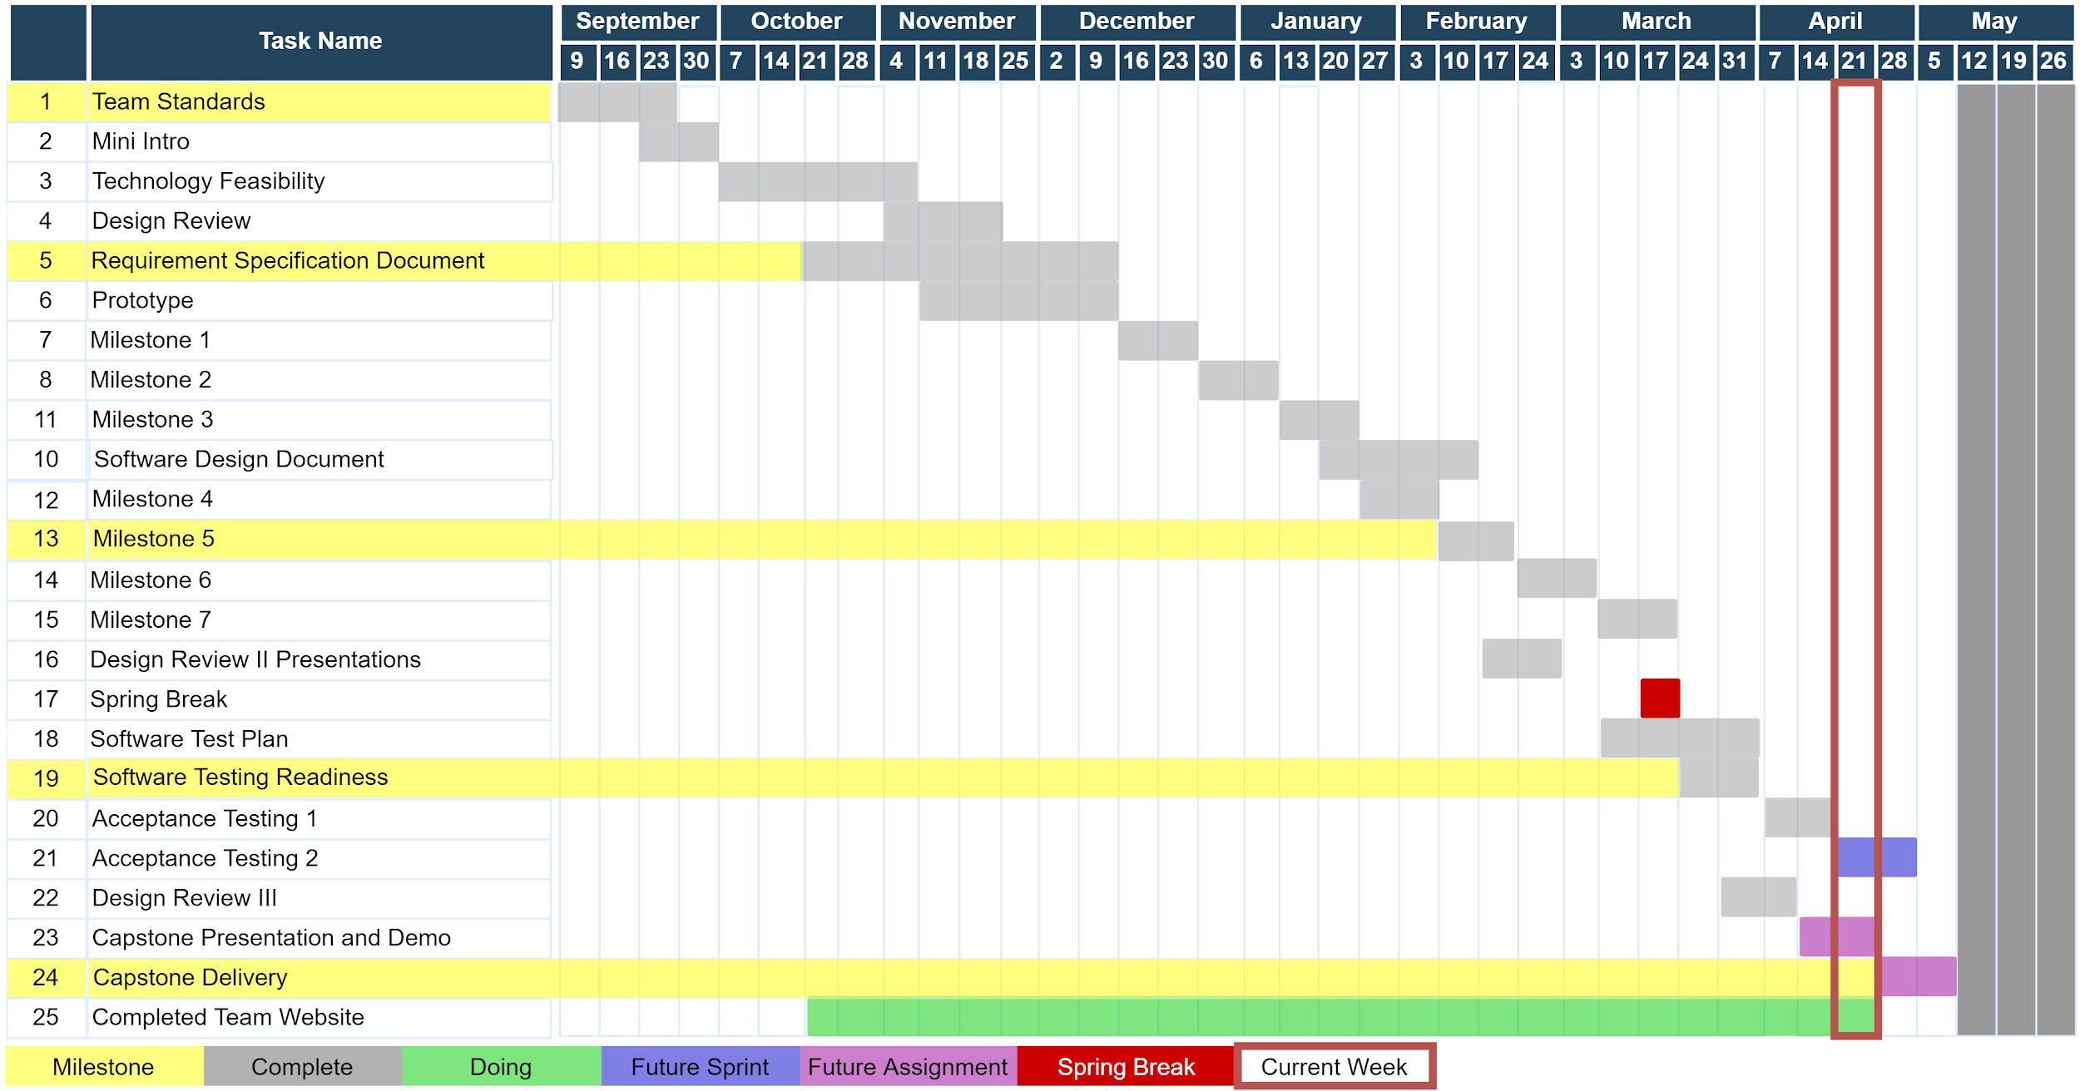
Year at a Glance
Notes:
[Joseph]
1 minute to 1:30
= in red → this week
= in yellow → personal milestones
= on the left → are the previous previous tasks, completed in grey
= in the middle → in green, are the assignments we are currently working on
= on the right → are the future tasks.
== in blue, are planned sprint items
== in purple, are future capstone assignments
<end>
Gantt chart
Explain the chart better, resize the chart
Change color, red bad,
Use red to indicate maybe a problem atm
Color green where we are
Yellow what we are doing
Grey, yet to do
Red for dead/late
3 col, duration, start, end, not useful

Slide 24
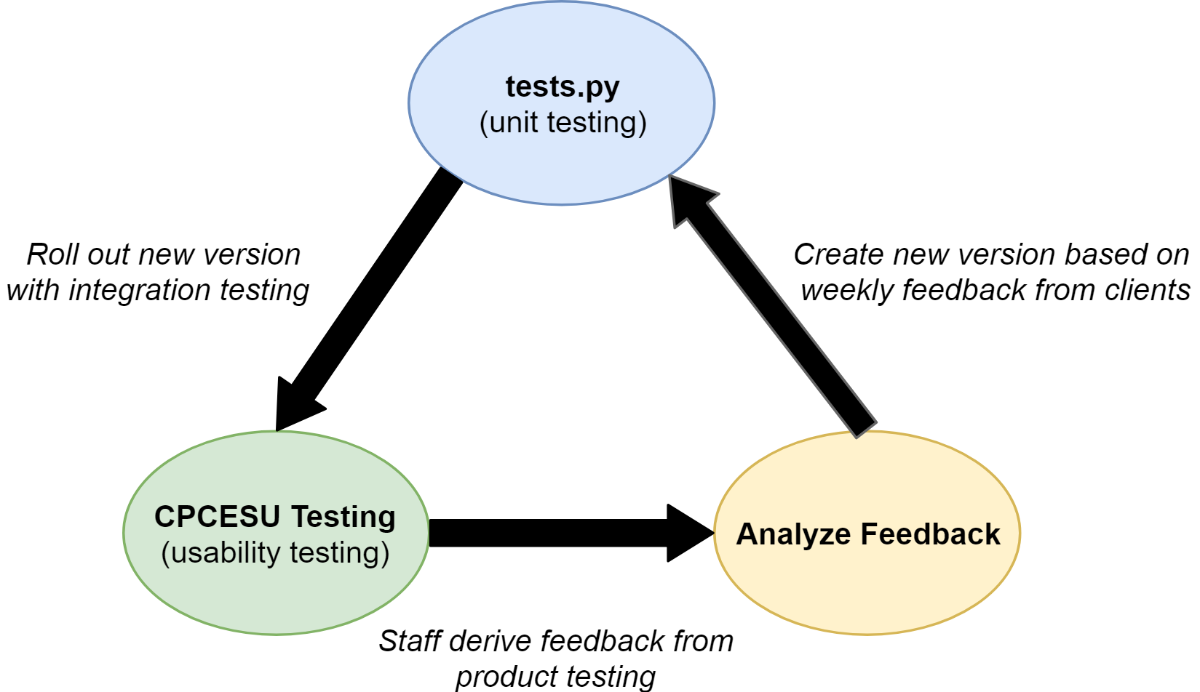
Testing Plan Overview
Testing Results: Decreased clicks and less time spent on data entry
Notes:
[Joseph]
Overview of Testing plan (Graphic)
Key element of testing
What the element is
Types of testing
Expected outcome
Summary

Slide 25
Conclusion
Notes:
[Colton]
This can be rolled out to other CPCESU’s as they also have this same problem
1:30
Take opposite of intro, funnel out from solution, problem, cpcesu, to world impact
This may become national system
So as ECOders, we’re gonna provide the CPCESU with the ability to work on things that matter, such as project statistics, and predictions to help them with future projects. They shouldn’t be wasting their time on scouring an ad hoc database.
Project management system
Project reporting, querying, and statistics
Reduce paper waste
Decrease lost work hours
Uniformed system and processes
Validation of data

Slide 26
Broader Impacts
Better reporting to NAU and other organizations
Future Development
  Can become the national network’s system
  Searchable experts for easier project assignments
Aiding conservation projects and the environment
Notes:
[Colton]
15 seconds
BROADER IMPACT TO THE REST OF CPCESU
This may become national system
So as ECOders, we’re gonna provide the CPCESU with the ability to work on things that matter, such as project statistics, and predictions to help them with future projects. They shouldn’t be wasting their time on scouring an ad hoc database.
Project management system
Project reporting, querying, and statistics
Reduce paper waste
Decrease lost work hours
Uniformed system and processes
Validation of data

Slide 27


CPCESU Project
Management System
Joseph Remy | Colton Nunley | Jasque Saydyk
Team Lead Editor-in-Chief UI Designer Lead | Architect Customer Communications QA Manager | Business Analyst Recorder Release Manager
remy@nau.edu | crn79@nau.edu | jrs496@nau.edu
Poster Presentation: Space 18C, Union Fieldhouse, 2pm to 4pm http://bit.ly/ECOders
Notes:
[Colton]
30 seconds top

Slide 28
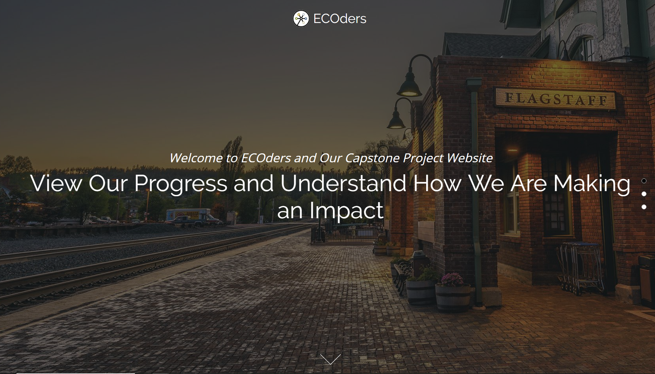
Website

Slide 29
CPCESU Project
Management System
Joseph Remy | Colton Nunley | Jasque Saydyk
Team Lead Editor-in-Chief UI Designer Lead | Architect Customer Communications QA Manager | Business Analyst Recorder Release Manager
remy@nau.edu | crn79@nau.edu | jrs496@nau.edu
http://bit.ly/ECOders
Notes:
[Colton]
30 seconds top

Slide 31
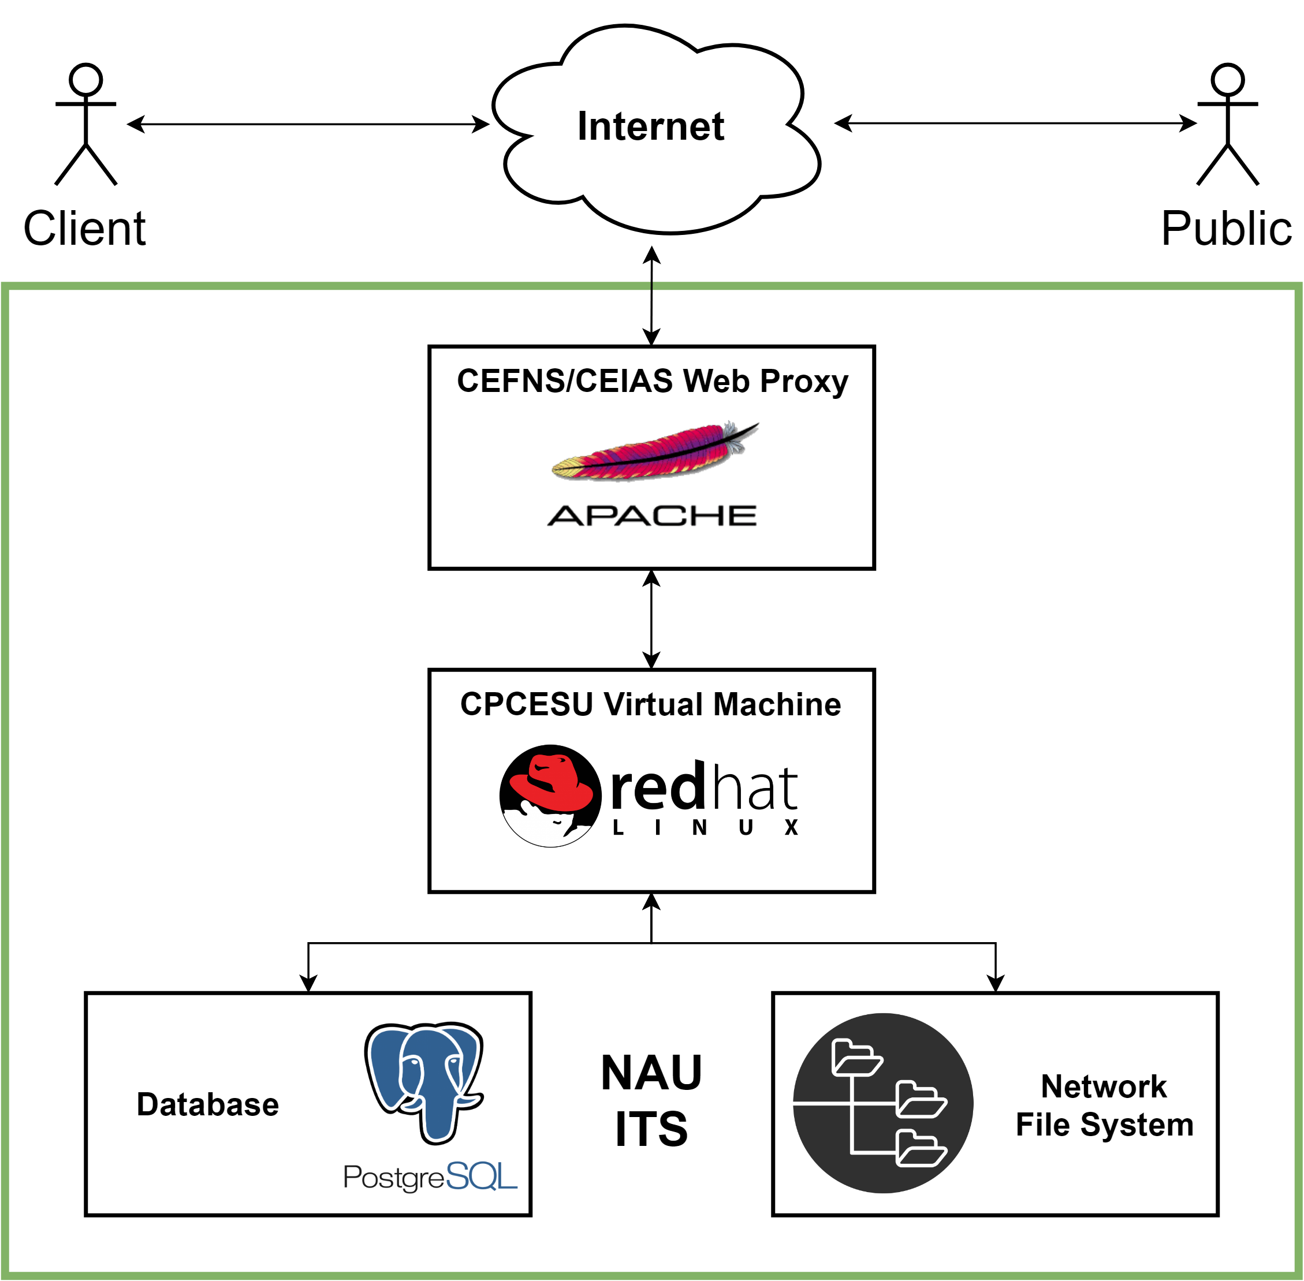
Solution Server Deployment Diagram
Notes:
[Joseph]
30 seconds - 1 minute
Since the system is hosted by ITS, there are several systems in place to host our virtual machine
First, at the top, is a web proxy to make the system indirectly accessible from the Internet
Next is our virtual machine, which hosts our solution
Lastly, the virtual machine is supported by two other systems.
The first is a Postgres instance running on another system, supporting the institution
The other is a network file system which handles the storage of our files and is supported with backups

Slide 32
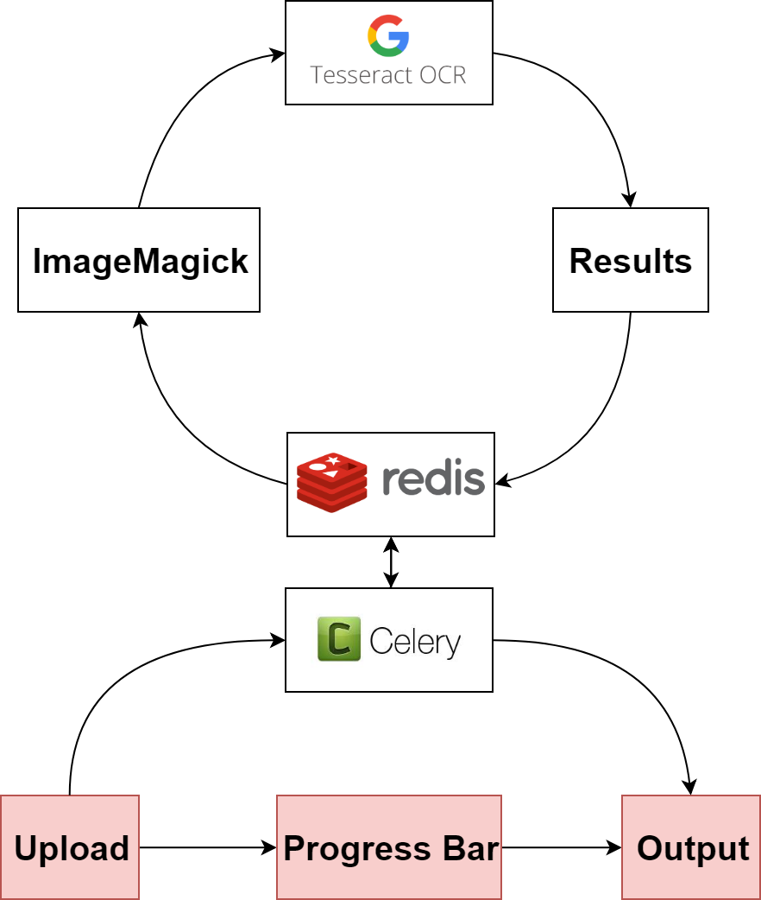
Autofill System Diagram
Notes:
[Jasque]
30 seconds - 1 minute

Slide 33
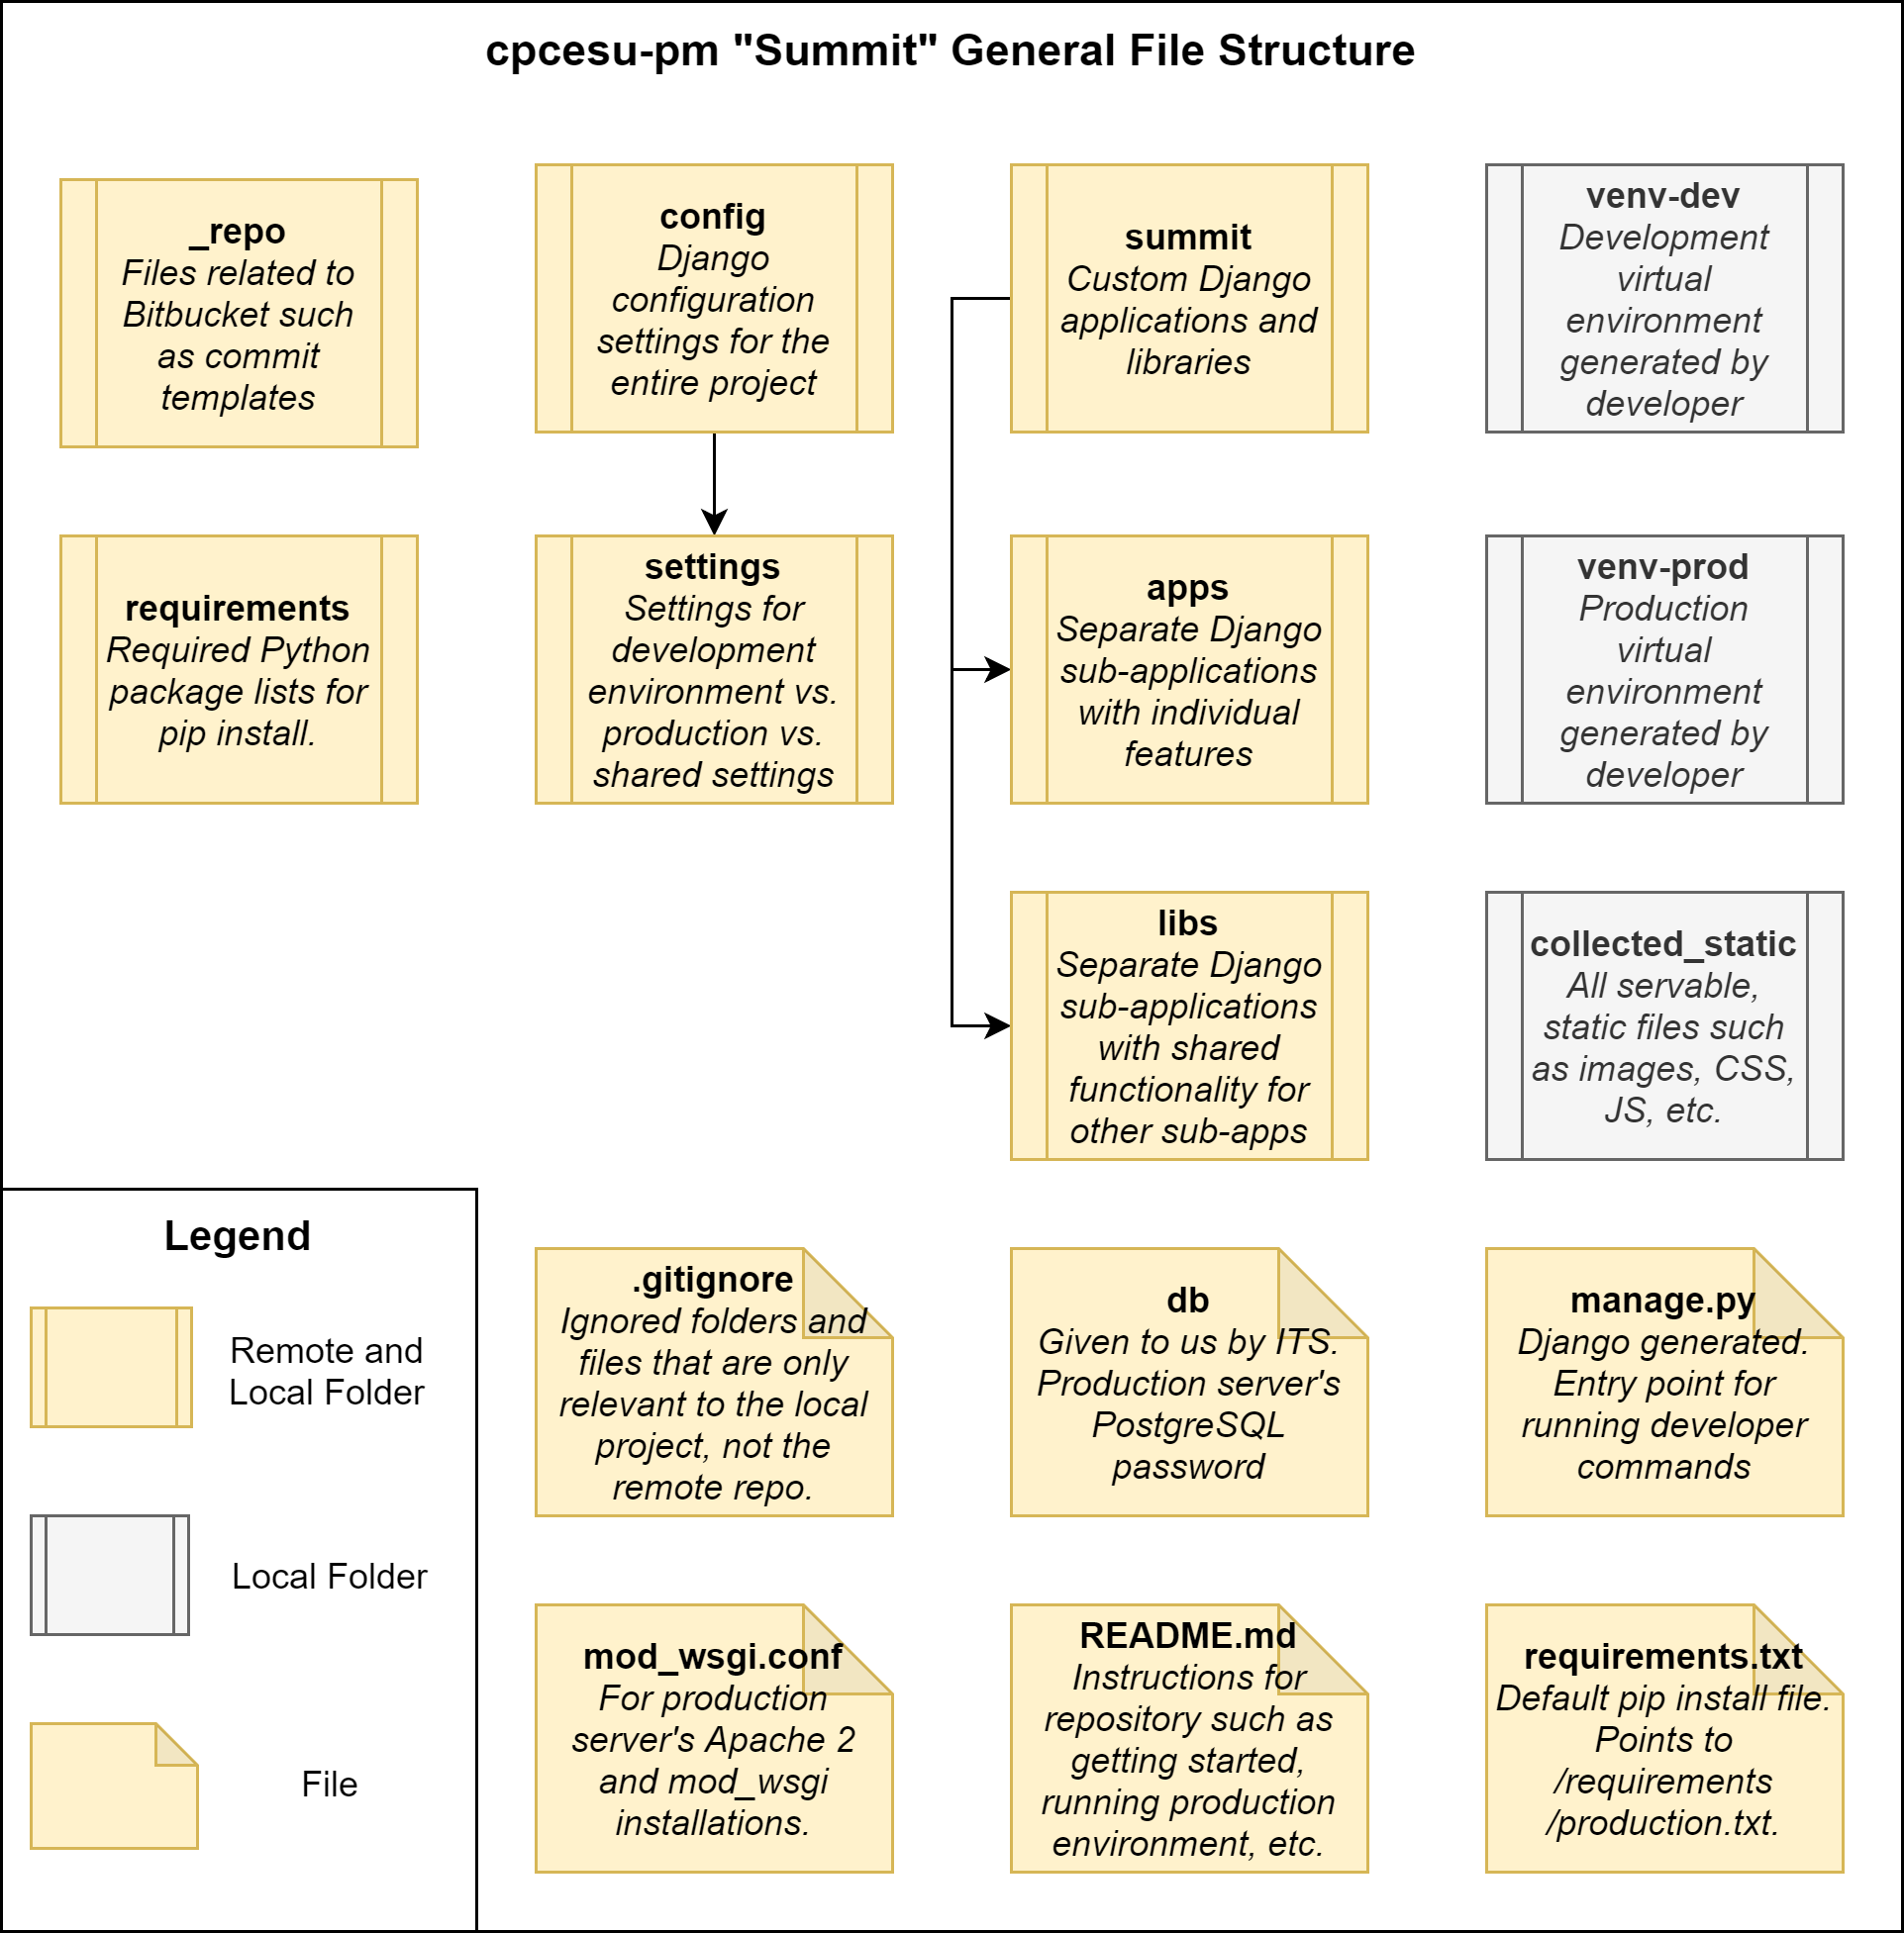
File System Tree
cpcesu-pm “Summit” General File Structure
Notes:
[Joseph]
A major part of our project is how we’ve organized it.
Project root folder structure at a glance
1st and 2nd columns are for configuration of the repo, the Django project, and Python dependencies.
3rd column is where the meat of the project exists as applications and custom and 3rd party libraries
Last column are automatically generated folders for run time using Django and our own custom commands
Lastly, yellow = stored locally and remotely as Git repo, gray is specific to the local folder (not uploaded by .gitignore rules)

Slide 34
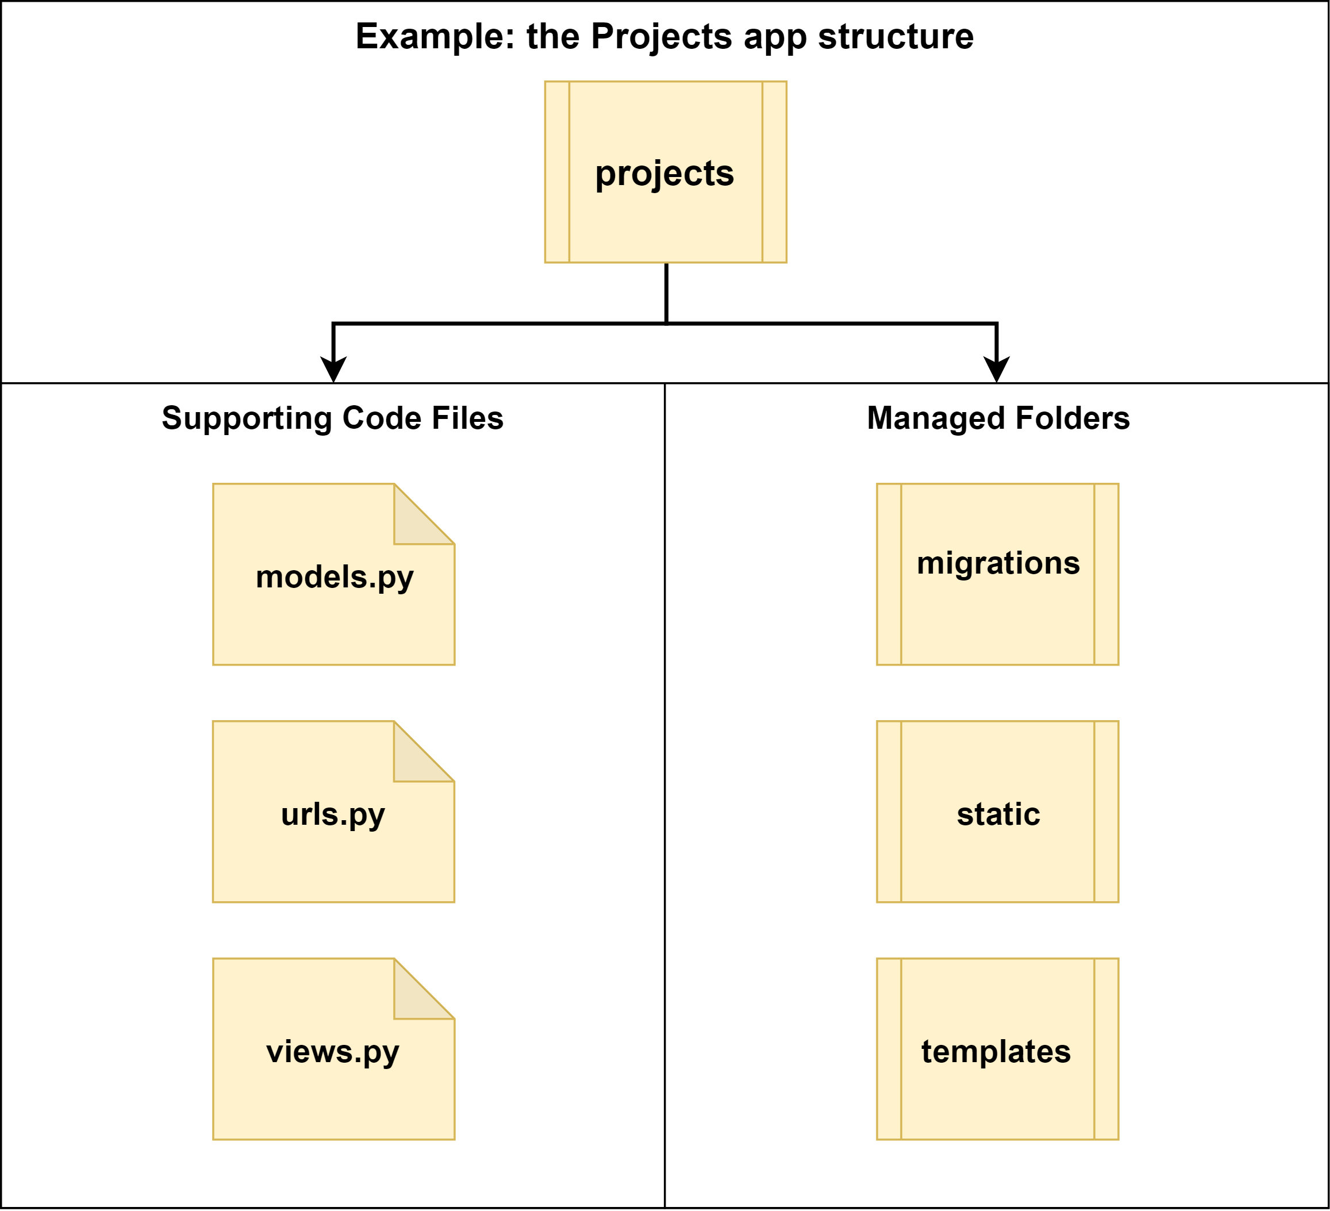
Sub-application Structure
Notes:
[Joseph]
One of the key modules is our project management application called “projects.” The file tree is shown here.
The left 2 columns are all files generated by Django when you first create a sub application.
And each part contributes to the Model-View-Controller or MVC paradigm in one form or another.
Ex: forms.py and views.py both contribute to the View aspect of MVC
The right side has 3 folders, all of which contain code-first database migrations managed by Django, HTML templates for views, and any static or fixed servable files for the user such as stylesheets, JavaScripts, logos, etc. respectively

Slide 35
A Few Core Sub-app. Files
Ex: the projects app.
summit/apps/projects folder
models.py | urls.py | views.py
Database Models | Route Controller | Generating Views
Project Modification Revision | Index “/projects” Add Project “/projects/add” Project Details: “/projects/detail/<id>” Edit Project: “/projects/edit/<id>” | Index - List View “templates/index.html” Add Project - Create View “templates/project_create.html” Project Details - Detail View “templates/project_list.html” Edit Project - Update View “templates/project_update.html”
Notes:
[Joseph]
Now, a more in-depth look at our core files for the projects app.
In our models.py (first column) is our database models. Project is self-explanatory with supporting Modification and Revision history models for projects.
Urls.py (second column) is our routing controller to our different front-end views. Example: for the projects’ app’s index, we use “/projects”
In the last column, views.py covers the different user interfaces. Again, the example for the index is a list view of all of the projects and uses the template “index.html” in the projects app folder.

Slide 36
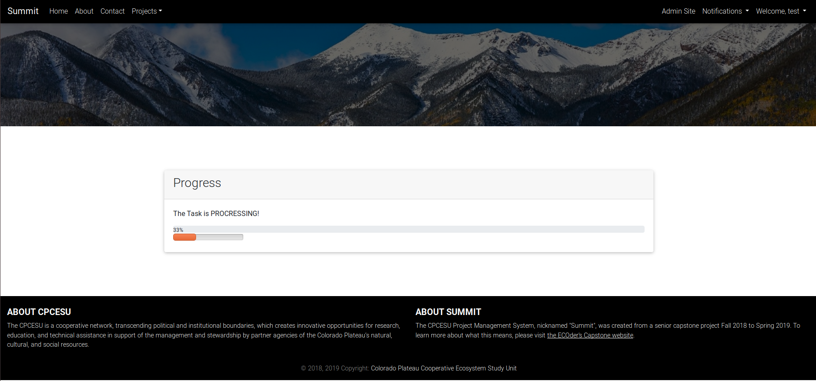
Current Status - Autofill
Decreasing entry lag time of project data
Notes:
[Jasque]
Looks through these documents, pulling out as much relevant data from them as possible, decreasing the entry lag time of a project being introduced to the CPCESU to it being

Slide 37
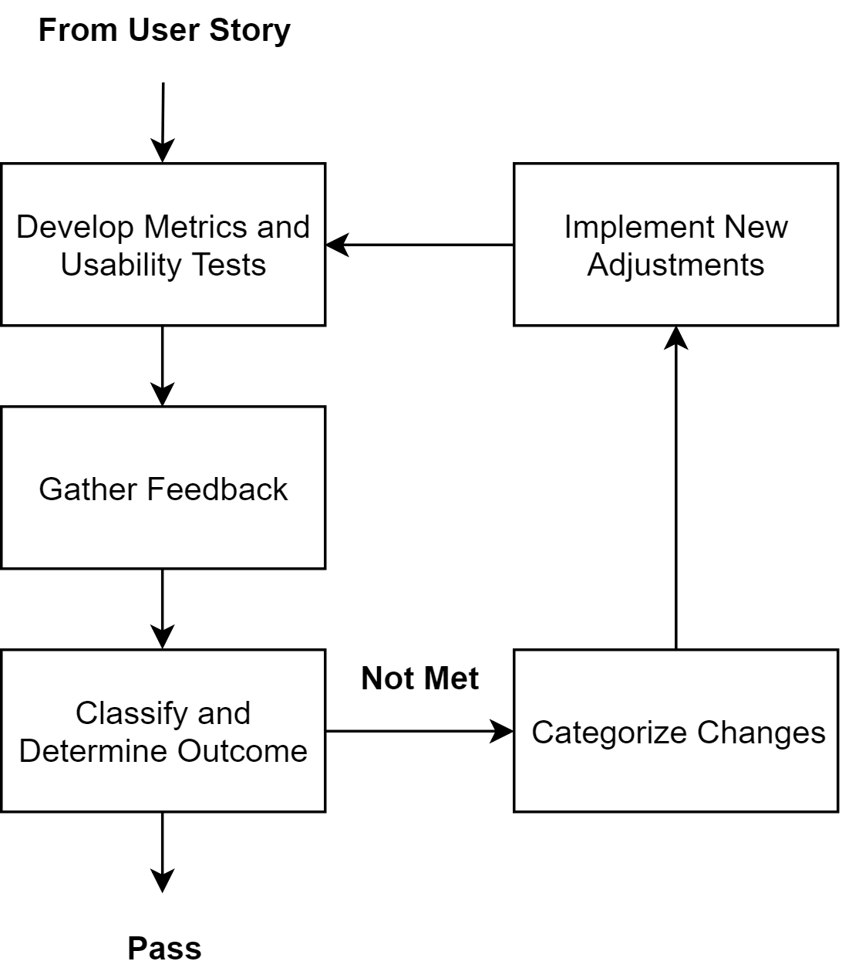
Usability Test Flow
Example Metrics:
Timing how long it takes to create a project
Counting clicks to create project
Notes:
[Joseph]
Describing user testing
From user story, say creating a new project, make metrics and tests
Metrics for measurable results
Examples the timing and number of clicks to create a project.
From here, translate feedback → determine outcome
Pass is pass, requirement or requirements are complete
Not met means changes need to be done
Changes → the user interface, features, fixing bugs, and so on
After implementing adjustments, rinse and repeat

